Slide 1


Text Classification & Sentiment Analysis
Enkhchimeg Tsendnyam

Slide 2
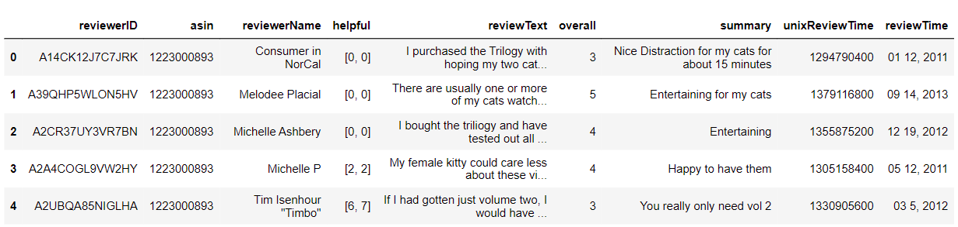

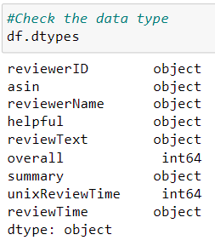
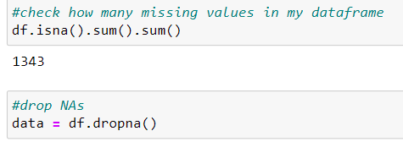
Amazon Pet Supplies Review Data
“Amazon Review Data (2018)” dataset has over 230 million number of reviews and the dataset includes data from May 1996 to October 2018. The sample dataset that used here is sub-set, per category data on pet supplies’ reviews.

Slide 3
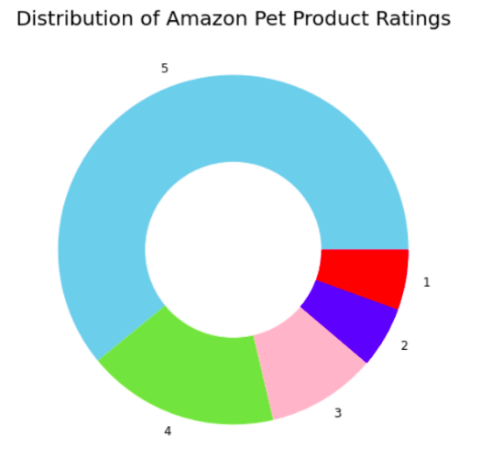
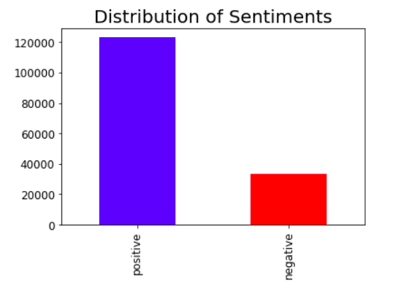
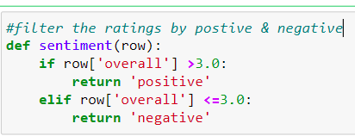
Basic Graphs

Slide 4
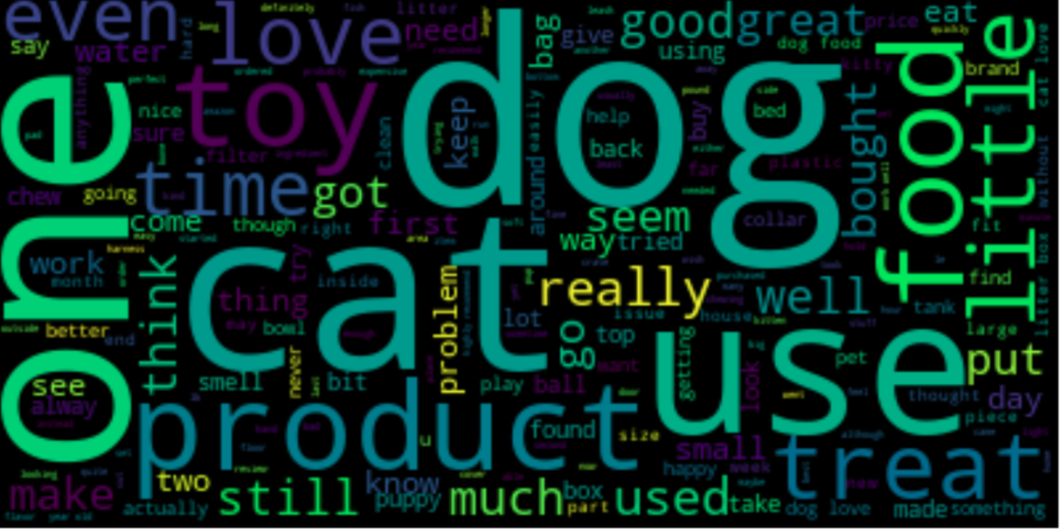
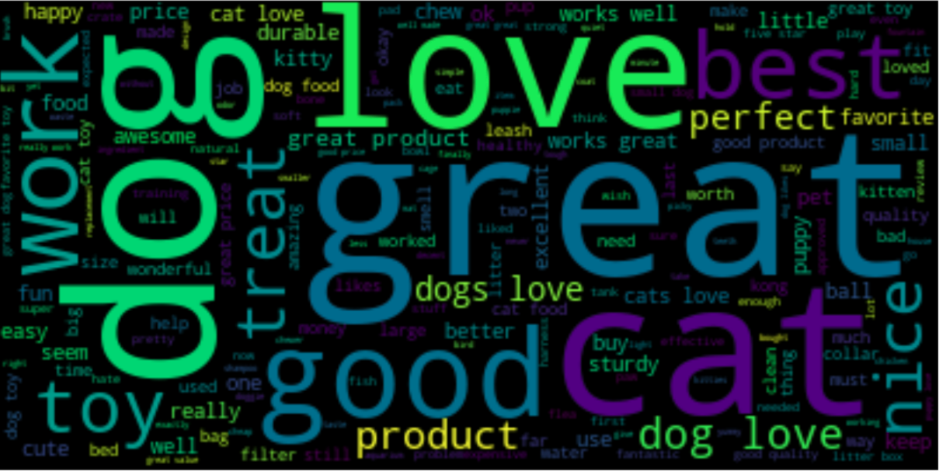
Word Cloud
The most common words in reviewText
The most common words in summary

Slide 5

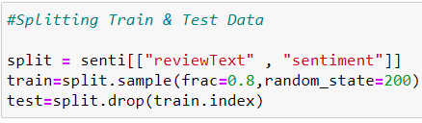
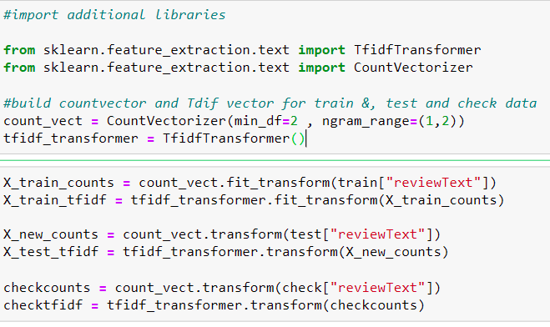
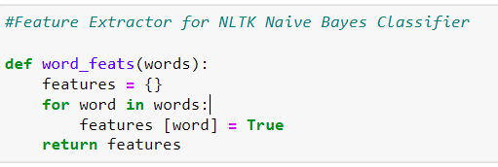
Getting Data Ready for ML Classifiers

Slide 6
MACHINE LEARNING CLASSIFIERS

Slide 7
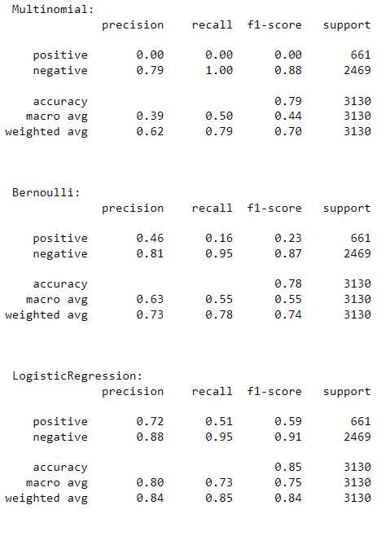
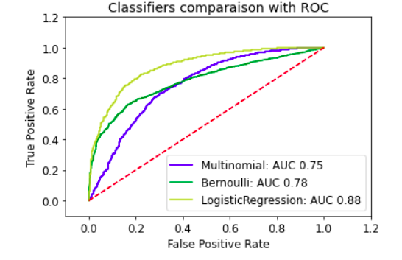
MODEL EVALUATION

Slide 8
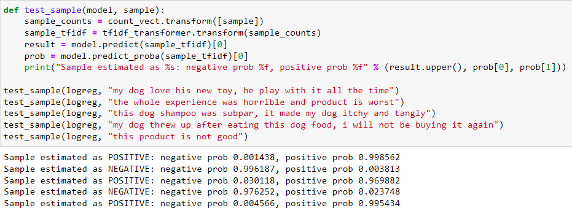
SENTIMENT ANALYSIS - TESTING CLASSIFIERS WITH SAMPLES

Slide 9
References:
References:
Ni, J. (2018). Amazon Review Data (2018). Amazon review data. Retrieved January 30, 2022, from https://nijianmo.github.io/amazon/index.html
“Amazon Review - Machine Learning Project¶.” Amazon-Review-Classification, https://t-lanigan.github.io/amazon-review-classifier/.
Bhattacharyya, S., Goled, S., Bhorayal, R., & Choudhary, A. (2021, February 2). How to implement LSTM RNN network for sentiment analysis. Analytics India Magazine. Retrieved January 30, 2022, from https://analyticsindiamag.com/how-to-implement-lstm-rnn-network-for-sentiment-analysis/
Roy, A. (2020, July 12). A guide to text classification and sentiment analysis. Medium. Retrieved January 30, 2022, from https://towardsdatascience.com/a-guide-to-text-classification-and-sentiment-analysis-2ab021796317
Wikimedia Foundation. (2022, February 6). Amazon (company). Wikipedia. Retrieved February 7, 2022, from https://en.wikipedia.org/wiki/Amazon_(company)

